Slide 1
Infrastructure as Code
Fredrik Skogman

Slide 2

Hi, I’m Fredrik
Fredrik Skogman
Principal Architect at Pingdom, part of SolarWinds Cloud
Located in Västerås, Sweden
Primary focus is Pingdom product: back end, infrastructure, and front end

Slide 3

This is Pingdom
Customers
Target sites
Alert management
Probes
Collectors
Reports
Clients

Slide 4
Infrastructure requirements
Different services have different hardware requirements (instance type and count)
Multiple database clusters with different hardware requirements
Multiple event processing system (streaming data, message queues)
Different services are deployed in different networks with different firewall rules
Each service has its own set of permissions to access other services (databases, message queues, etc.)
APIs located behind load balancers
All logs are forwarded to a specific log management system
Monitoring and alerting

Slide 5

Automate or fail
Manual management is bound to fail: human factor
Misconfiguration
Doing tasks in the wrong order, etc.
Non-existing or out-of-date documentation
Lots of repetitive work
Risk of snowflake servers/configuration drift
Risk of misconfigured or missing monitoring/alerting

Slide 6
Enter automation
Configuration management tools (Chef®, Puppet®, SaltStack®, etc.)
Usually used for server provisioning (installing patches, libraries, daemons, etc.)
Generation of configuration files
Orchestration/provisioning tools (Terraform®, CloudFormation)
Usually used for hardware provisioning (instance type, number of instances, etc.)
Keeps a stored state of the system
Allows for trivial referencing across systems (e.g., map a database cluster to a set of application nodes)

Slide 7
Declarative or imperative
Declarative
Describes the desired state
Immutable infrastructure
Imperative
Describes how to achieve the desired state
Can lead to config drift

Slide 8
Imperative
Example (made up)
- launch_instances:
count: 10
image: ami-xyz
instance_type: hw.type.x

Slide 9
Declarative
Example (made up)
resource "hw_instance" "example" {
count = 10
image = "ami-xyz"
instance_type = "hw.type.x"
}

Slide 10
Declarative - continued
Example (Terraform)
resource "aws_security_group" "collector" {
name = "${var.pingdom_environment}-a-collector"
vpc_id = "${var.vpc}"
ingress {
from_port = ${from_port}
to_port = ${to_port}
protocol = "TCP"
security_groups = ["${aws_security_group.collector_elb.id}"]
}
}
module "ecs_collector" {
source = "../ecs"
pingdom_environment = "${var.pingdom_environment}"
load_balancers = ["${aws_elb.collector_elb.name}"]
num_instances = "${var.collector_instance_count}"
instance_type = "${var.collector_instance_type}"
security_groups = ["${aws_security_group.collector.id}"]
subnets = ["${var.public_in_subnets}"]
}

Slide 11

Infrastructure as code
Easy (fast) to reproduce a system
Version controlled infrastructure
Safe rollbacks
Easy to collaborate
Perform changes and create a PR
Share modules between teams
Infrastructure can be unit tested
Easy to manage multiple environments
Safe updates to infrastructure – dry run

Slide 12
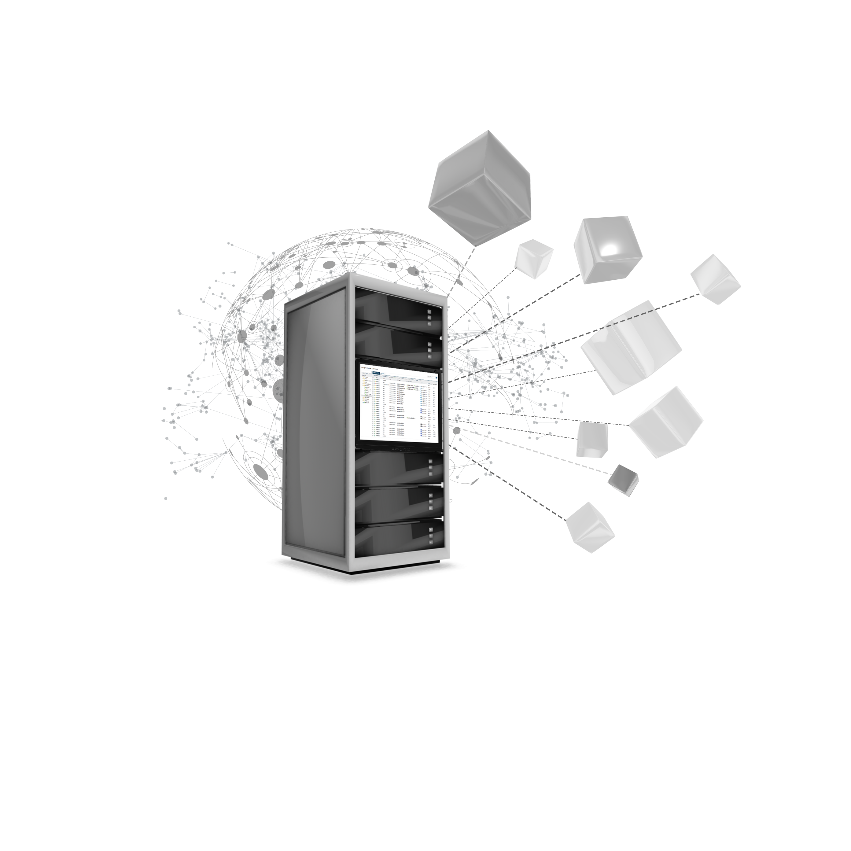
Monitoring and alerting
Monitoring agents configured along with the infrastructure
Alerting for both infrastructure and products
Different alert policies
Different alert targets

Slide 13
What works for us
SRE team owns the infrastructure
Developers collaborate by creating PR when needed. SRE reviews
Terraform for static resources
Reusable modules - one per service
Per environment overrides (e.g., hardware size and count)
SaltStack for services (e.g., databases)
Homogenous cluster for product deployments
Capture dependencies in containers

Slide 14
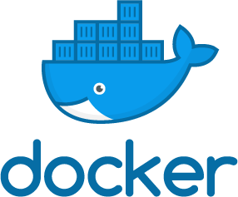
How we manage products
Clear separation of modules and products
Module is a self contained container
Containers are stateless
Configuration is added via environment variables
Scale up by deploying more container instances
Each module has its own development life cycle
Peer review
Integration tests

Slide 15
Products
A product is mainly metadata
What container to use?
Version of container
Configuration for each container
Credentials not part of configuration (added later)
Products are version controlled
Peer review
Rollbacks, etc.
Each product has its own development lifecycle

Slide 16
Deployment
Deployment is a single function with two arguments
Environment (production, system-test, etc.)
Product (including version)
Deployment automatically performs the following tasks:
Choose hardware cluster to deploy to
Create a deployment artifact with necessarily credentials
Push artifact to chosen cluster
Spin up the product

Slide 17
Monitoring
Per-product monitoring may need to be added by developers
Metrics
Use a log management system than can create alerts from logs
APM (AppOptics™) can auto generate valuable metrics
External monitoring to keep track of customers experience (Pingdom®)

Slide 18
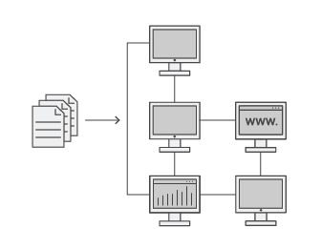
Pros
Infrastructure as application code
Agile
Iterative
Continuously improved infrastructure
Dare to experiment—learn from failures
Rollback is easy, remember?

Slide 19

Caveats
Naming is important, namespace your components
Stricter requirements for product development (such as 12-Factor App)
Don’t reinvent the wheel—use a mature CI & CD system
Start small, think big

Slide 20
That’s it!
Thank you!

